Slide 1
Computer Science Career Trends
By: Hrithik Shah

Slide 2
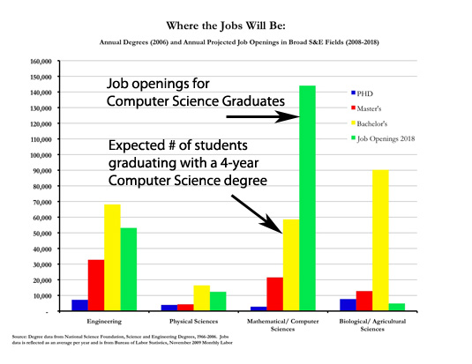
Trends at the Local, National & International Level
Lots of Jobs in the computer fields will be open in the next couple of years as Baby Boomers retire.

Slide 3
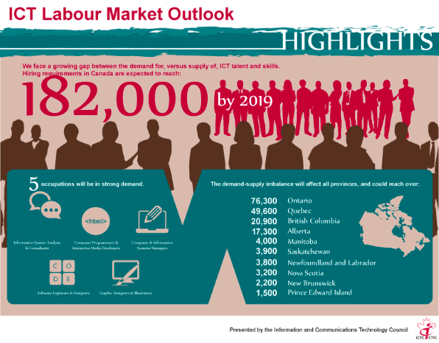
Trends at the Local, National & International Level
The Information and Communications Technology state that by 2019, over a 182,000 jobs will open up in Canada.

Slide 4
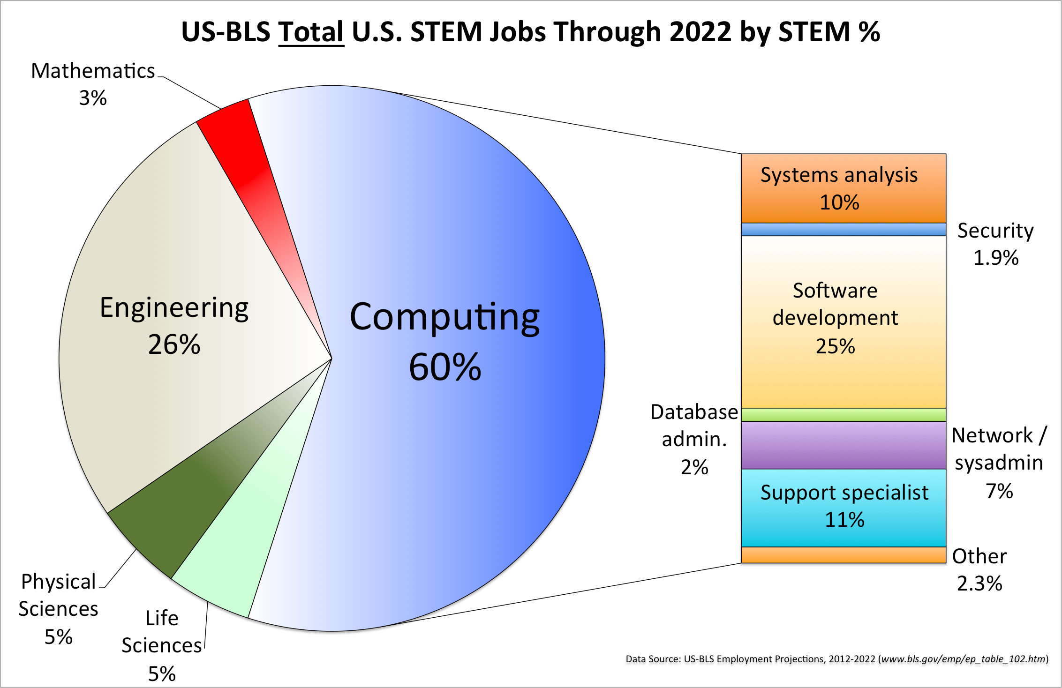
Trends at the Local, National & International Level
As you can see the amount of Job Openings for the computer field is increasing and will have greatest number of job opportunities in the future.

Slide 5
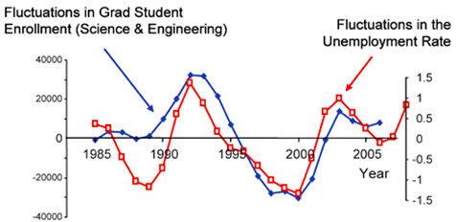
Trends at the Local, National & International Level
There is an interesting statistic that shows that when enrollment in fields such as computer science increases, then so does the unemployment rate.

Slide 6
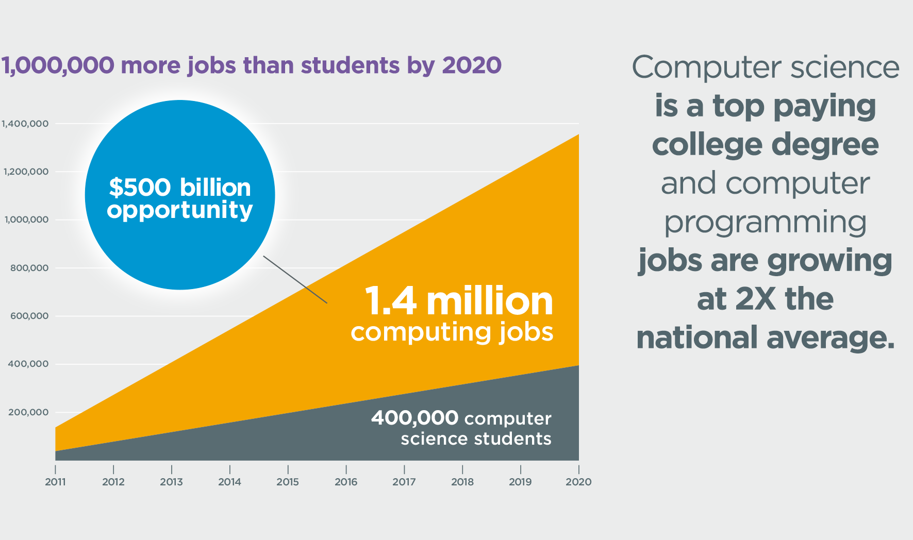
Careers in the Computers Field

Slide 7
Effect on my Decision
From the research that I conducted, I found that the amount of job opening will only be increasing as the years pass by. I also found that the job openings for physical sciences such as astronomy will decrease. Therefore, a job in the computer science field will be beneficial later in life. In addition, computer science is a very interesting field that has many advantages.

